Slide 1

Contact Stress
MET 4501
LEAH GINSBERG, PH.D.

Slide 2
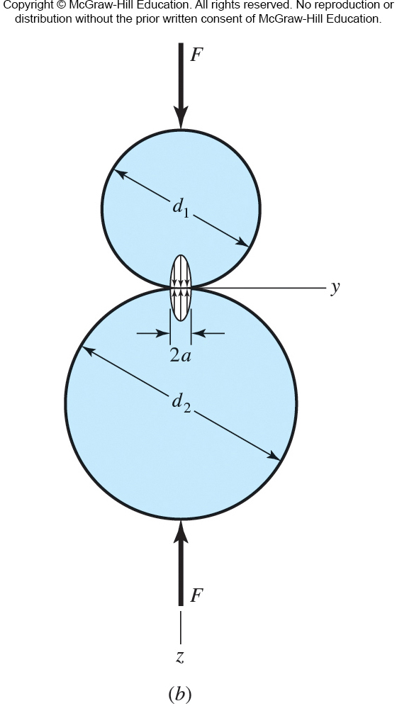
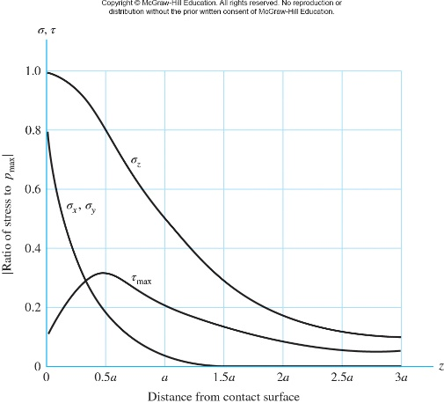
Sphere-on-sphere Stresses
Fig. 3−37
Fig. 3−38

Slide 3
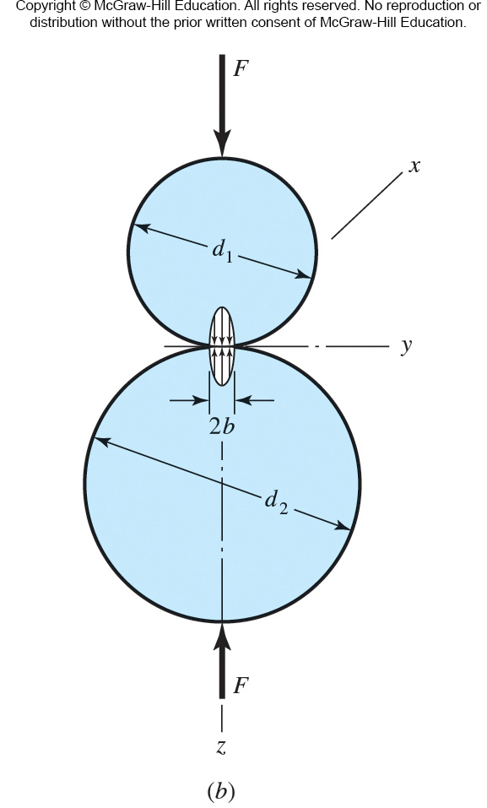
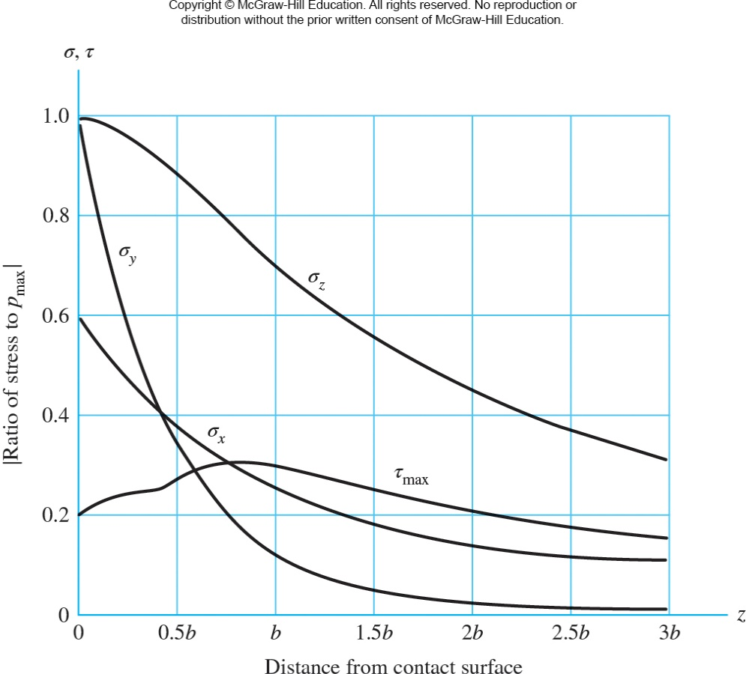
Cylinder-on-cylinder Stresses
Fig. 3−39
Fig. 3−40

Slide 4
Bearings
MET 4501
LEAH GINSBERG, PH.D.

Slide 5
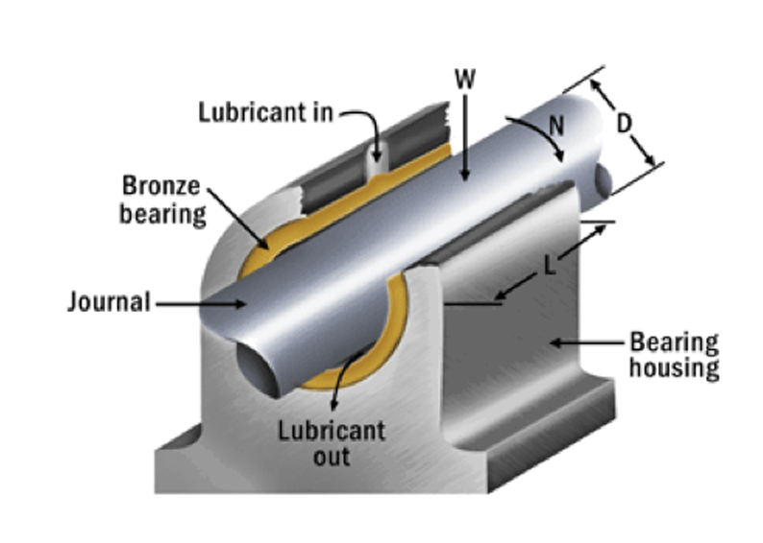
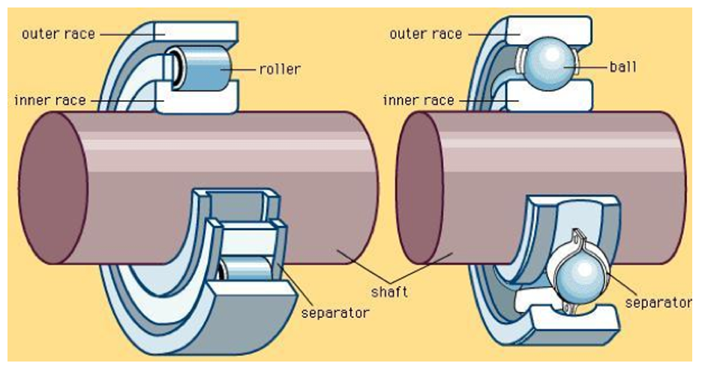
Journal bearing vs. rolling-element bearings
Components of a journal bearing
Components of a rolling-element bearing (REB)

Slide 6
Journal bearings

Slide 7
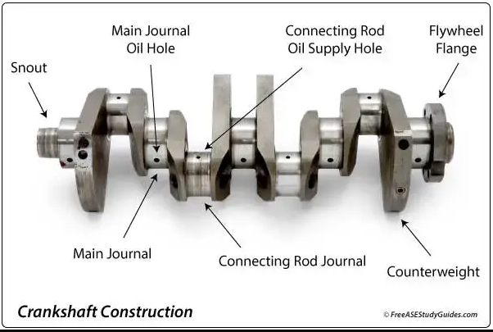
Journal bearings

Slide 8
Rolling element bearings (REB)

Slide 9
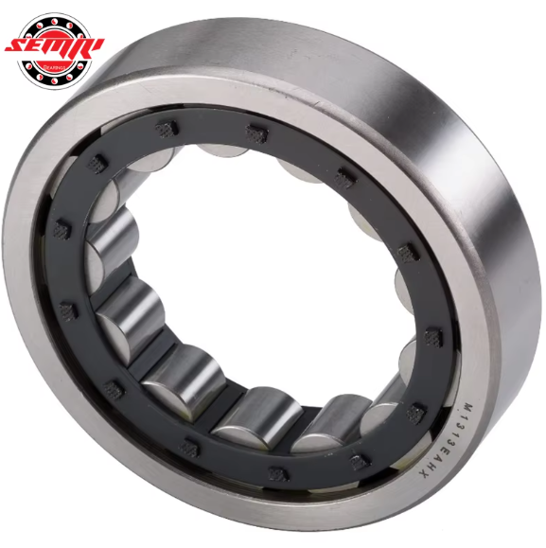
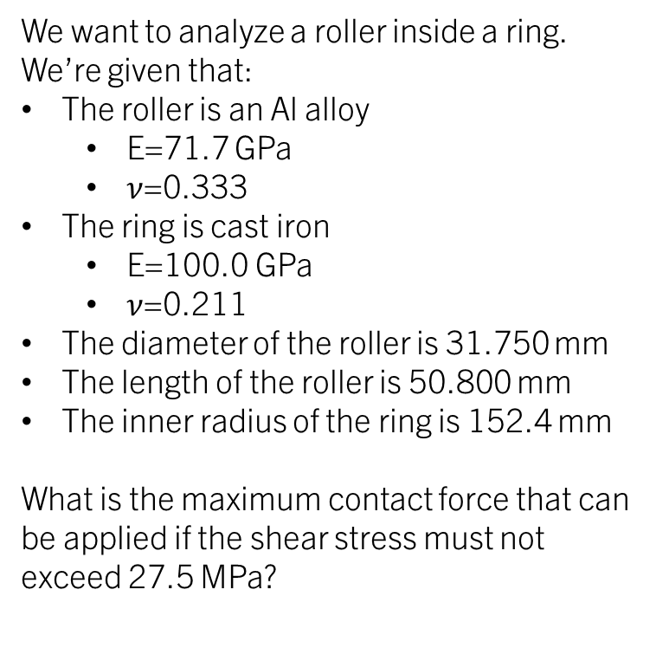
Example: Roller in a ring
We want to analyze a roller inside a ring. We’re given that:
The roller is an Al alloy
E=71.7 GPa
$ν$=0.333
The ring is cast iron
E=100.0 GPa
$ν$=0.211
The diameter of the roller is 31.750 mm
The length of the roller is 50.800 mm
The inner radius of the ring is 152.4 mm
What is the maximum contact force that can be applied if the shear stress must not exceed 27.5 MPa?
Table A-5

Slide 10
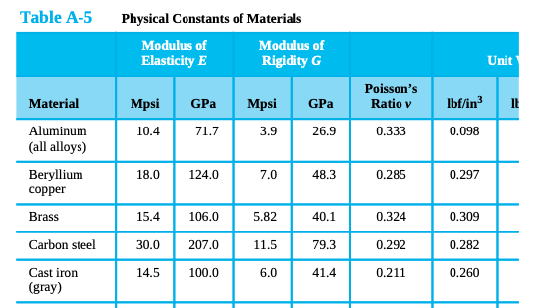

Slide 11
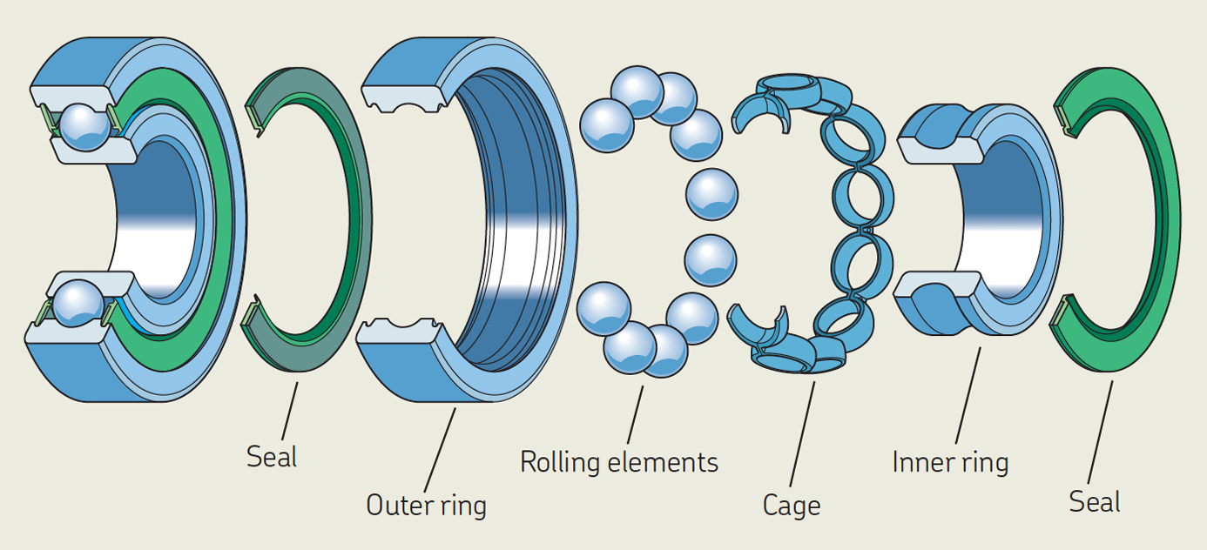
Rolling element bearings (REB)
REB manufacturers are an excellent resource for technical information.
NSK (Tokyo, Japan): https://www.nsk.com/am-en/
NTN (Osaka, Japan): https://ntnamericas.com/
Schaeffler (Herzogenaurach, Germany): https://www.schaeffler.us/us/
SKF (Gothenburg, Sweden): https://www.skf.com/us
Timken (North Canton, Ohio): https://www.timken.com/products/timken-engineered-bearings/

Slide 12
Rolling element bearings (REB)
A typical REB consists of an inner ring, an outer ring, rolling elements, and a cage.
The primary purposes of the cage are:
Separating the rolling elements to reduce the frictional heat generated in the bearing.
Keeping the rolling elements evenly spaced to optimize load distribution.
Guiding the rolling elements in the unloaded zone of the bearing.
Retaining the rolling elements of separable bearings when one bearing ring is removed during mounting or dismounting.

Slide 13
Rolling element bearings (REB)
Roller bearing
Ball bearing

Slide 14
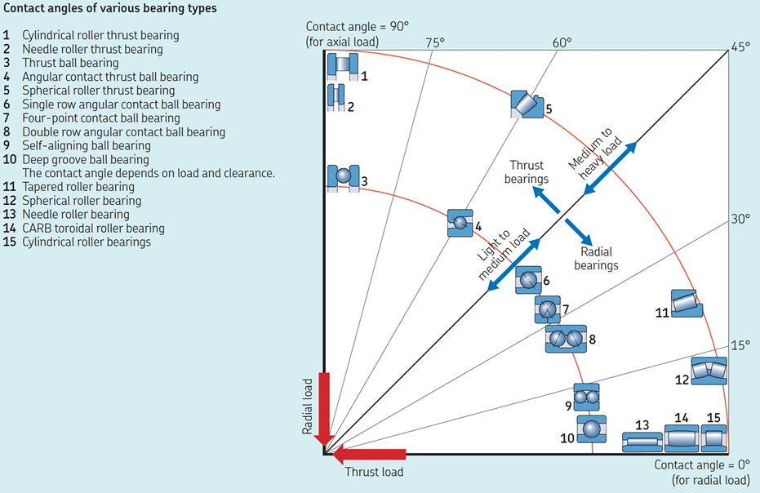
Rolling element bearings (REB)

Slide 15
Journal bearing vs. rolling-element bearings
Journal bearing
Rolling-element bearing (REB)
Motion | Sliding between the journal and bushing | Rolling between balls/roller and raceway
Stresses | Distributed over a large surface area, reducing peak stresses | Point contact, leading to higher localized stresses
Life | Can last longer if properly lubricated and maintained | Finite fatigue life based on material and load conditions
Friction | Higher friction but can be minimized with proper lubrication. | Lower friction due to rolling contact.
Operating speed | Better suited for high-speed applications | Suitable for moderate to high speeds, but with limitations and very high speeds

Slide 16
Journal bearing vs. rolling-element bearings
Journal bearing
Rolling-element bearing (REB)
Cost | Generally lower initial cost but may require higher cost for maintenance. | Higher initial cost but less frequent maintenance expenses.
Noise | Quiet in operation when lubricated properly. | Noisier due to rolling elements and potential for vibration.
Load Capacity | High load capacity, especially for radial loads. | Lower load capacity compared to journal bearings of similar size.
Maintenance | Requires regular lubrication and maintenance. | Lower maintenance, but more prone to damage if not properly installed or lubricated.
Typical applications | Engines, turbines, compressors, pumps | Electric motors, gearboxes, machinery, automotive wheels

Slide 17
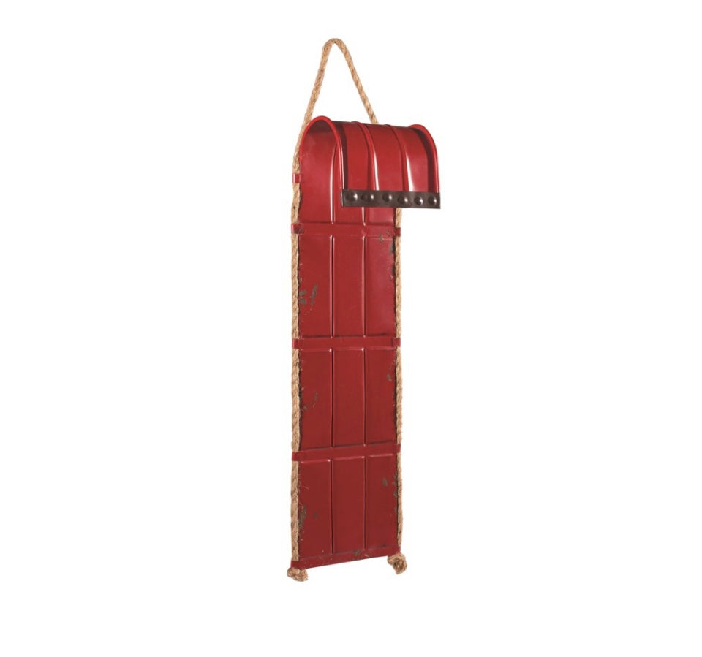
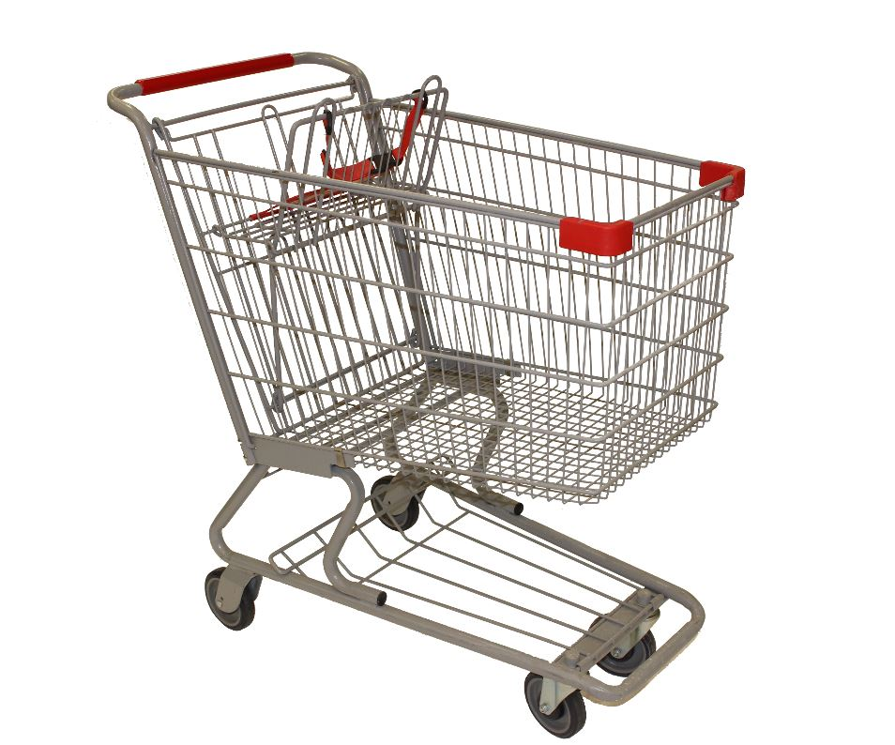
Example Question 1
You and a friend are competing to see who can get down the hill from the ET building to Stingers dining hall the fastest. You’re considering two designs:
Design A
Design B

Slide 18
Example Question 1 (cont.)
Which design can carry more weight?
Design A
Design B

Slide 19
Example Question 1 (cont.)
Assuming both will carry the same weight, which will be faster?
Design A
Design B

Slide 20
Example Question 1 (cont.)
Which do you expect will cost less?
Design A
Design B

Slide 21
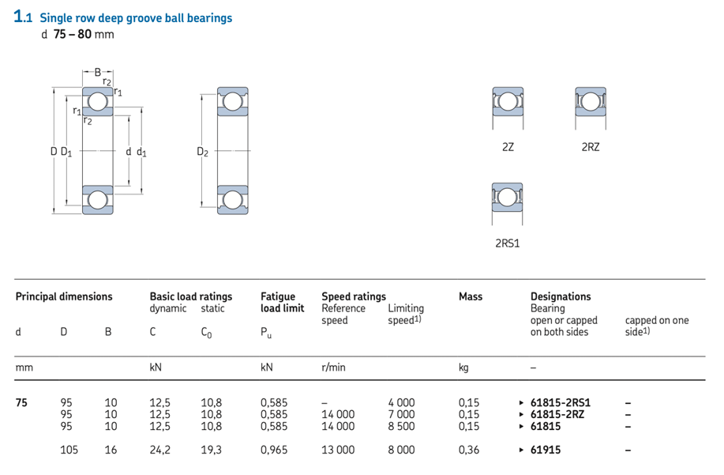
Example Question 3
Consider an SKF (which rates its bearings for 1 million revolutions) ball bearing. If you desire a life of 5000 hrs at 1725 rev/min with a load of 1792 N with a reliability of 90%, for which catalog rating would search in an SKF catalog?
Does this bearing meet the requirements?

